Slide 1
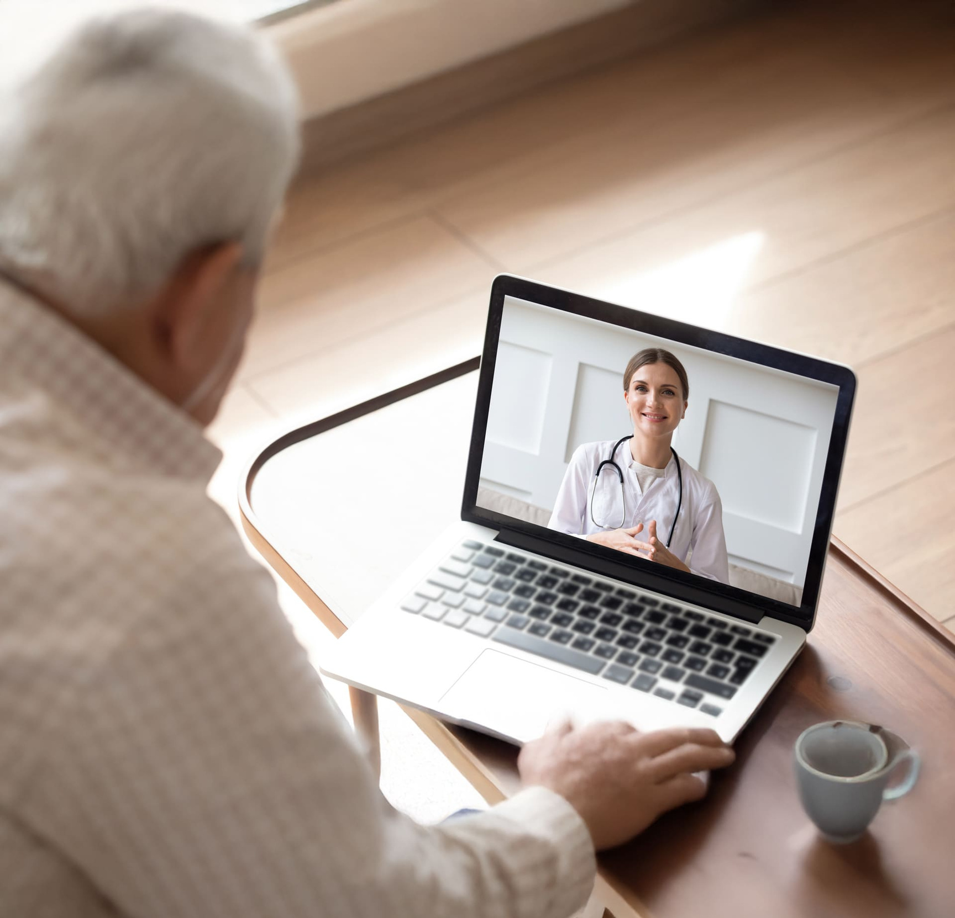

HOMECARE
Advanced Remote Patient Monitoring
Integrated Telemedicine Solutions for Enhanced Healthcare
Notes:
1

Slide 2

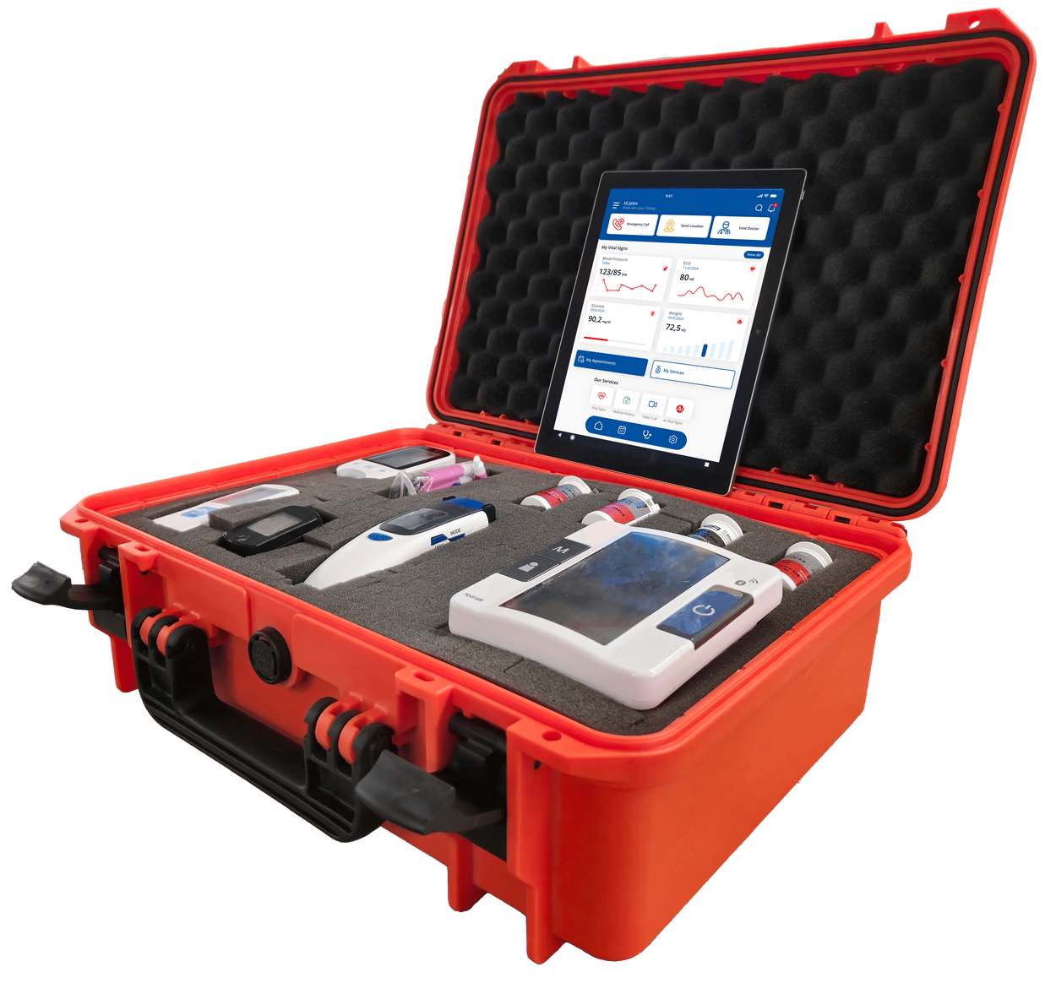

What is
Homecare
Homecare is a comprehensive remote patient monitoring and telemedicine solution designed to enhance healthcare accessibility and efficiency. By integrating advanced medical devices, AI-driven monitoring, and real-time consultations, it ensures patients receive timely, proactive care from anywhere.
Chronic disease patients who need continuous monitoring and medical support.
Elderly individuals requiring real-time health tracking and emergency assistance.
Healthcare providers seeking seamless patient data access and remote consultation capabilities.
Caregivers & families who want to ensure the safety and well-being of their loved ones.
www.tma.gr
Notes:
2

Slide 3
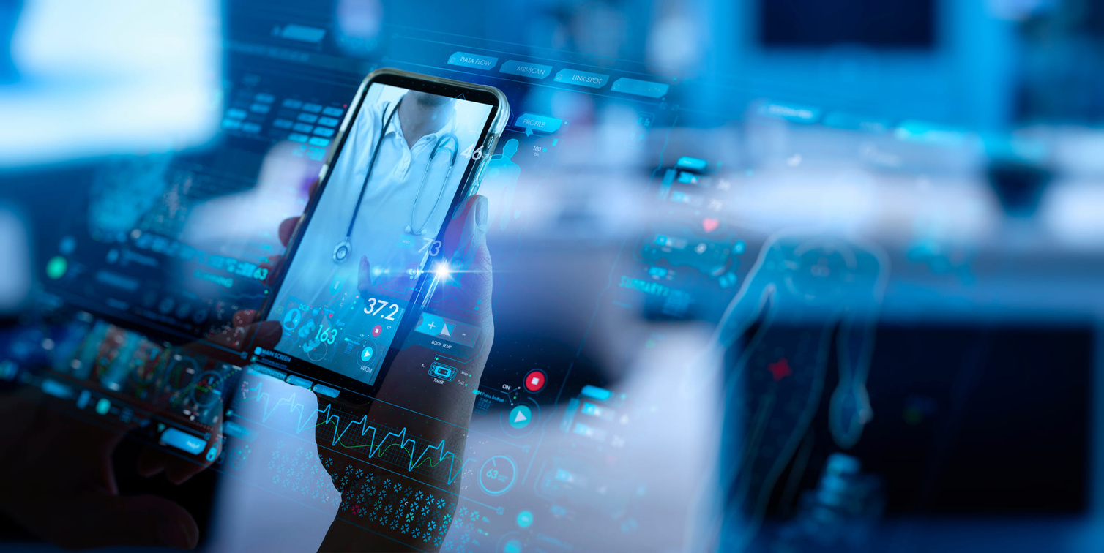

How does it work
Homecare combines portable medical devices, secure cloud-based health records, and AI-powered insights to provide a seamless healthcare experience. Patients can monitor their vital signs using homecare medical kits, smartwatches, and GPS-enabled tracking devices, with data instantly transmitted to ePokratis Health Cloud for analysis.
Doctors can access this data remotely, provide real-time guidance, issue e-prescriptions, and intervene immediately in case of emergencies. This reduces hospital visits, improves response times, and enhances patient care.
By making healthcare more accessible, preventive, and data-driven, Homecare is shaping the future of telemedicine and remote monitoring.
www.tma.gr

Slide 4
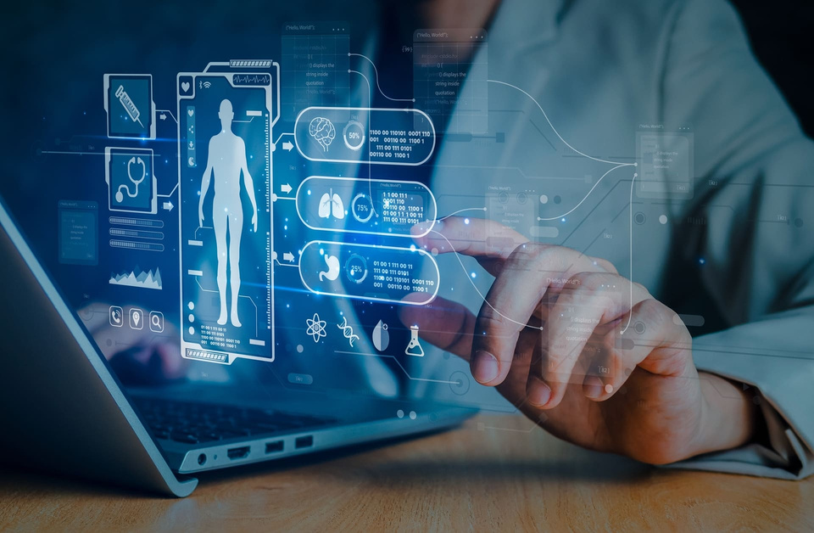



KEY
Benefits
Real-time health monitoring from anywhere
Enhanced patient safety with GPS tracking
Smartwatches and GPS-enabled devices ensure real-time location monitoring and emergency alerts.
Continuous tracking of vital signs with instant updates to healthcare providers.
Seamless communication with healthcare providers
Reduces hospital visits and improves patient outcomes
Video consultations, e-prescriptions, and remote medical advice at any time.
Early detection of health issues enables timely intervention, minimizing hospitalizations.

Slide 5
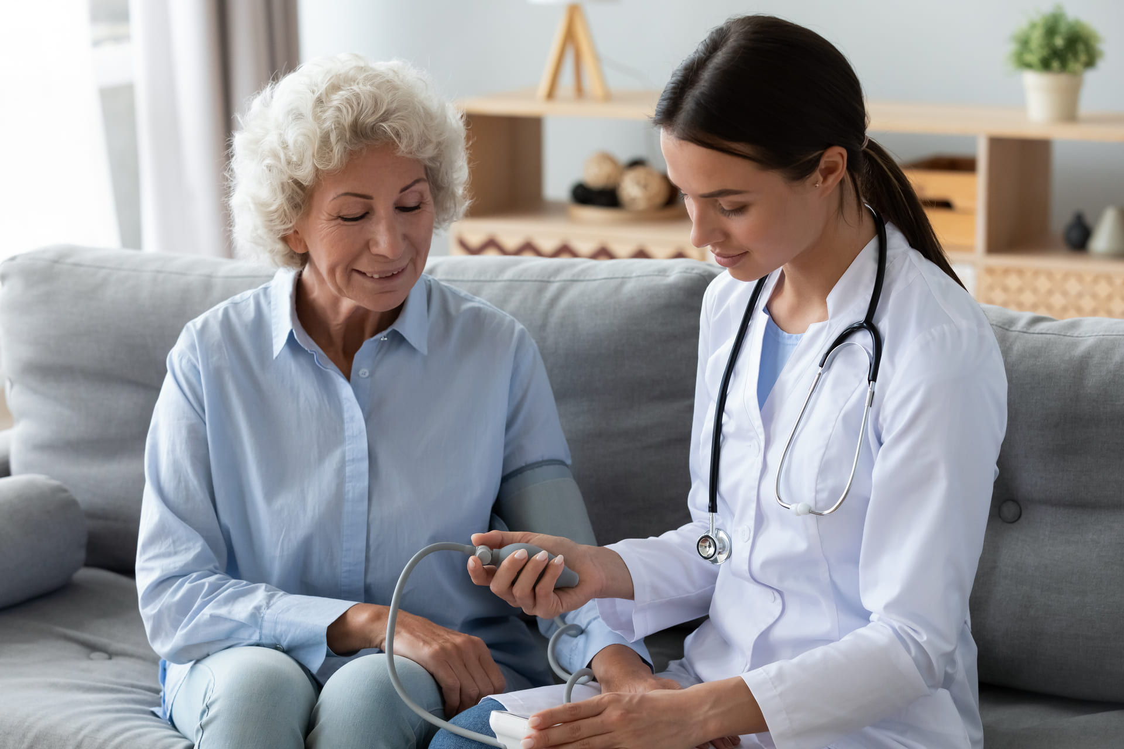

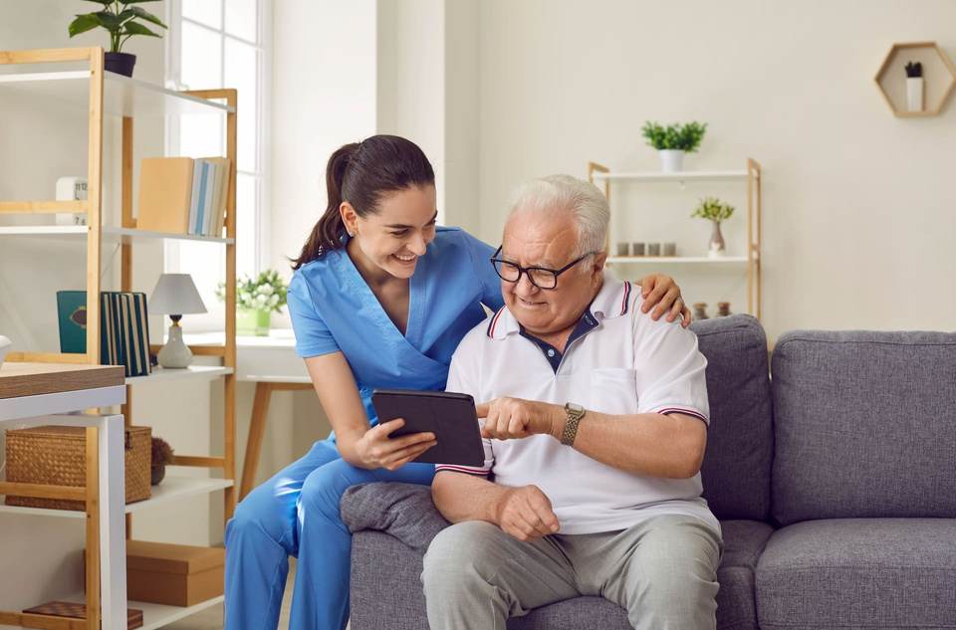
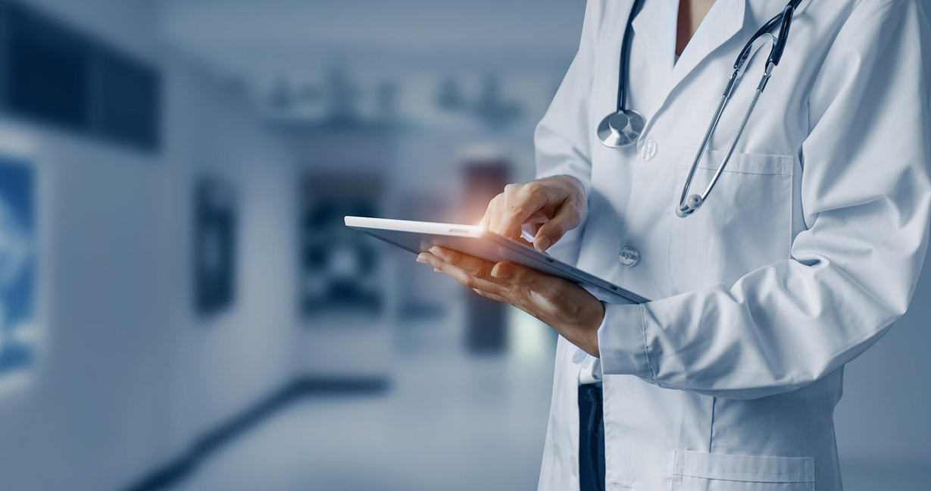
Homecare Medical Case
Comprehensive Diagnostics
The Homecare Medical Case is a rugged, portable telemedicine unit designed to provide comprehensive remote diagnostics. It is ideal for chronic care management, elderly health monitoring, and telemedicine consultations, ensuring timely medical intervention anytime, anywhere.
Equipped with ECG, SPO2, blood pressure monitor, and digital stethoscope for real-time health assessments.
Portable & Durable
Designed for easy transport, with a rugged build for use in any environment.
User-Friendly Interface
Seamless Data Integration
Simplifies health monitoring for both medical professionals and patients with minimal setup.
Connects with ePokratis Health Cloud, allowing instant data sharing and remote consultations.
www.tma.gr

Slide 6
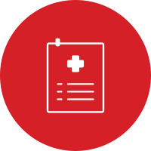


ePokratis
Health Cloud
ePokratis Health Cloud is a secure, cloud-based health management platform that enables real-time patient monitoring, teleconsultation, and seamless data sharing between patients and healthcare providers. It enhances accessibility, ensuring medical professionals can deliver timely and informed care.
Key Features
24/7 Access to Personal Health Records
Patients and doctors can securely view and update medical history, lab results, and treatment plans.
AI-Powered Health Insights
Advanced analytics detect trends and provide early warnings for potential health risks.
Telemedicine Video Calls & Prescription Management
Enables remote consultations, digital prescriptions, and direct communication with healthcare providers.

Slide 7



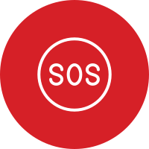
Solutions
GPS Geofence
GPS Geofence Solutions provide advanced location tracking using smartwatches and Airtag-style devices to ensure the safety of elderly and at-risk individuals. These solutions allow caregivers and healthcare providers to monitor movement, receive alerts, and respond quickly in emergencies.
Key Features
Real-Time Tracking & Alerts
Instantly locates individuals and notifies caregivers of any unusual movement.
Geofencing for Restricted Movement Areas
Set up safe zones and receive alerts if the user exits predefined locations.
SOS Emergency Button for Immediate Help
One-touch SOS function alerts caregivers or emergency services instantly.

Slide 8
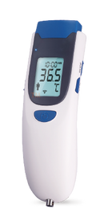
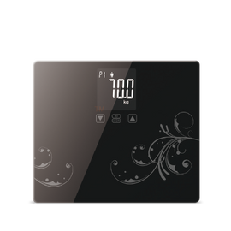
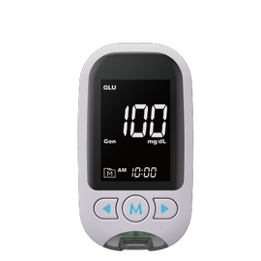
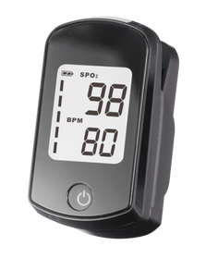
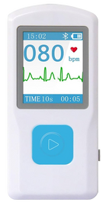
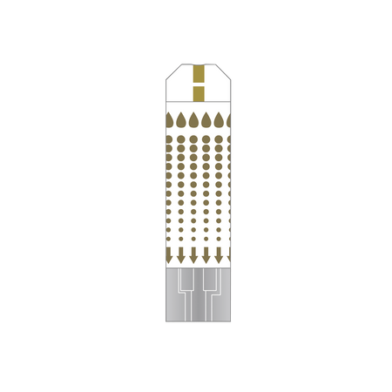
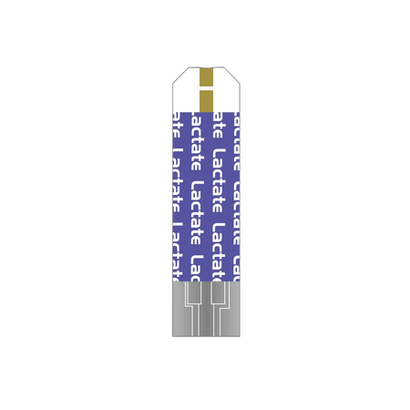
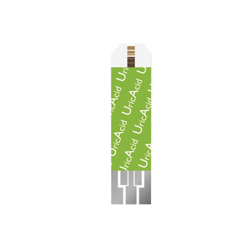
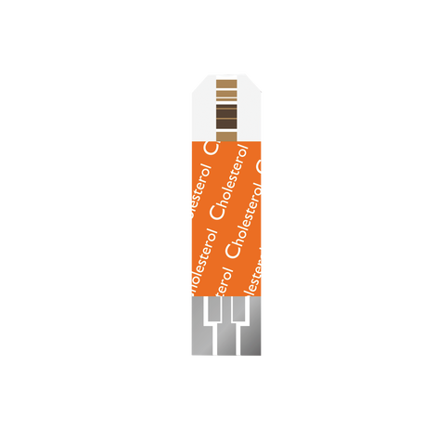
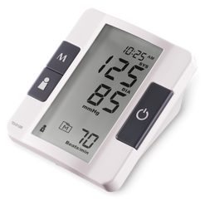
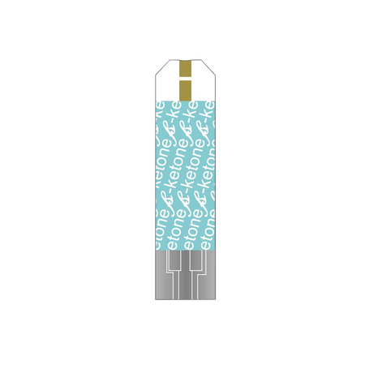
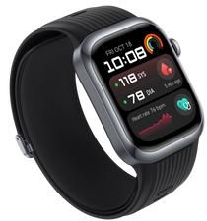
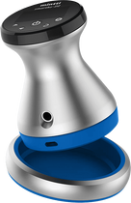
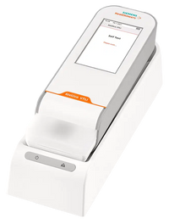
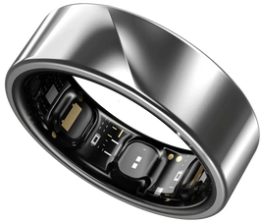
HOMECARE EXTRAS
Medical Devices
TMA Homecare’s advanced equipment ensures accurate health monitoring, making telemedicine accessible and effective from any location.
Fingertip Pulse Oximeter
Non-Contact Forehead Thermometer
Portable ECG Monitor
Digital Weight Scale
Multi Parameter Meter
Blood Pressure Monitor
Glucose Strip
Lactose Strip
Uric Acid Strip
Cholesterol Strip
B Ketone Strip
Digital Stethoscope
Troponine Meter
Smart Watch
Smart Ring
1
2
3
4
5
1
2
3
4
5
6
6
7
8
9
10
7
8
9
10
11
12
11
12
13
14
15
13
14
15

Slide 9

Homecare
Equipment Overview
1
Rugged Tablet PC
Durable and optimized for seamless telehealth interactions.
Homecare provides a comprehensive range of telemedicine devices to support remote healthcare and patient monitoring.
Monitoring Screen
2
7" touchscreen with ECG, SPO2, and Wi-Fi connectivity for real-time health tracking.
Web Camera
3
High-definition video capabilities for clear and effective remote consultations.
4
Digital Stethoscope & Spirometer
Advanced diagnostic tools for precise remote assessments.
www.tma.gr

Slide 10
Homecare
Equipment Overview
Homecare provides a comprehensive range of telemedicine devices to support remote healthcare and patient monitoring.
5
Portable X-RAY Machine
Compact and powerful for remote imaging and faster diagnostics.
Multi-Measurement Device (NFC)
6
Conducts glucose, cholesterol, uric acid, and other essential health tests.
L03 Airtag-Style GPS Tracker
7
Compact and discreet device for real-time location tracking, geofencing alerts, and emergency assistance.
www.tma.gr

Slide 11
Extended Homecare Services
One complete homecare ecosystem, now extended with on-site presence, safety and urgent-trigger services - all delivered through the homecare cloud application.
Core Homecare Services
Extended On-Site Services
24/7 remote patient monitoring
Continuous vital-sign tracking with instant updates to care teams.
Caregiver presence assurance
Confirms care staff are in position where and when they should be.
Telemedicine consultations
Video calls, e-prescriptions and remote medical advice at any time.
Secure zones at the patient home
Protected areas around the home, with alarms for unspecified persons.
GPS & geofence tracking with SOS
Real-time location, safe zones and one-touch emergency help.
Automatic fall detection
Falls inside the secure zones trigger an immediate response.
Portable medical device suite
A complete telemedicine device ecosystem for home visits.
Voice & natural-language triggers
Recognises calls for help and urgent communication.
Secure personal health records
Cloud-based records accessible anytime, from anywhere.
Edge-processed, private monitoring
On-site intelligence with privacy-preserving camera processing.
Everything above is available in a single, unified homecare application.
www.tma.gr

Slide 12
On-Site Monitoring & Safety Services in the Home
Intelligent, on-site monitoring at each patient home - automatic, and fully integrated with the homecare cloud.
Presence & Position Assurance
Secure Zones
Confirms medical, paramedical and support staff are in position where and when a home visit is due.
Defines protected areas at the patient home and raises an alarm if any unspecified person is detected.
Automatic Fall Detection
Voice & Natural-Language Triggers
Detects falls within the secure zones and raises an automatic trigger for immediate response.
Camera microphones parse phonetic commands and natural speech to detect calls for help and urgent communication.
All of the above are delivered through the homecare cloud application, in a single, unified interface.
www.tma.gr

Slide 13
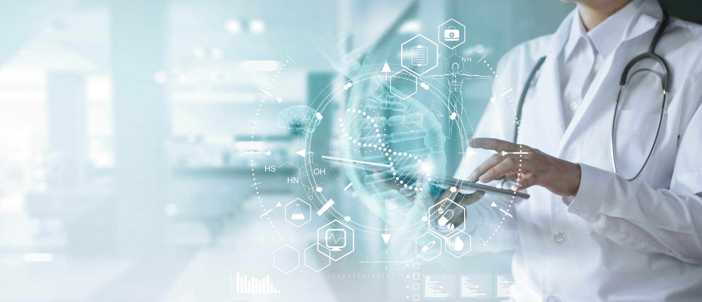




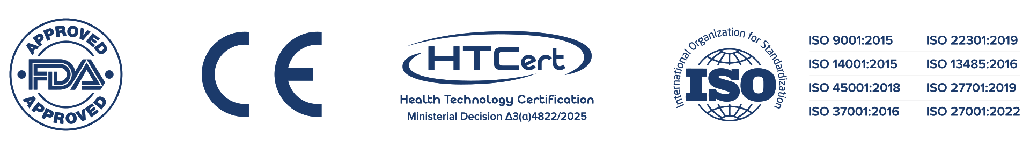
151 Al. Papanastasiou Avenue,
Piraeus, PC 18533, Greece
+30 211 1165 330
info@tma.gr
www.tma.gr

